Slide 1





Build with AI: Code for Communities
JANAVYUH
Team Name: PARTH
Sovereign Civic Intelligence & Public Investment Operating System
“From Every Voice to Verified Public Impact.”

Slide 2
PROBLEM STATEMENT
Core Problem
Requests for development by citizens reach governments via voice, messaging services, portals, hotlines, and even local mechanisms, but these messages are generally scattered between different departments and data systems.
Meanwhile, citizens' comments, demographic information, state of infrastructure, and investment programs do not naturally link up, which makes it hard to determine the actual requirement, analyze competing alternatives, and evaluate the results once the intervention is implemented.
Critical Gaps
01 – Fragmented Feedback
The requirements of citizens are fragmented into different mediums, languages, and departments.
02 – Volume of Complaints ≠ Needs
The digitally connected citizenry might have more feedback, while the under-connected might not be heard.
03 – Reactionary Planing
Current planning may provide today’s problems but not the future pressures on infrastructure.
04 – Project Complete ≠ Service Outcome
Projects deemed ‘complete’ do not equate to improvements in the outcome of services.
RELEVANT CONSEQUENCES
01 – Unseen Infrastructure Requirements
Even when there is a shortage of services, places with low reporting levels may remain unnoticed.
02 – Poor Resource Prioritizing
Due to lack of an evidence layer, planners are forced to analyze needs using separate data sets.
03 – Overlooked Demands of the Future
Focusing on existing demands does not consider any future demands due to population and service changes.
DECISION NEED
Governments need a unified intelligence layer that can connect citizen needs with infrastructure gaps, future demand, investment constraints, and measurable outcomes for evidence-based planning.

Slide 3
JANAVYUH | PROPOSED SOLUTION
THE JANAVYUH LOOP STAGES
JANAVYUH is a sovereign, multi-language Civic Intelligence & Public Investment Operating System that transforms citizen feedback and public data into:
civic data evidence -> infrastructure intelligence -> need prediction -> policy simulation -> decision making -> impact verification.
It is a decision-making layer by design and not a self-decision-making public spending authority.
01
02
03
04
05
06
HEAR
Voice • WhatsApp • IVR
SMS • USSD • Web • Kiosk
UNDERSTAND
Multilingual AI extracts
intent • place • urgency
CONNECT
Civic Need Graph +
Infrastructure Asset Graph
DISCOVER
Hotspots • Silent Zones
Anomalies • hidden needs
PREDICT
Future demand +
infrastructure stress
SIMULATE
Alternative projects +
budget scenarios
07
08
09
10
11
NEGOTIATE
Agents compare impact • equity
• cost • resilience
GOVERN
Authorized human decision
+ policy parameters
ACT
Approved priorities →
projects & implementation
PROVE
Outcome evidence +
Impact Receipt
LEARN
Measured results improve
future planning
KEY OUTPUTS
01 — Civic Evidence
Unified citizen + public data
02 — Priority Intelligence
Hotspots + future needs
03 — Decision Support
Projects + budget scenarios
04 — Impact Proof
Verified outcomes + Impact Receipt
FROM EVERY VOICE → EVIDENCE → SIMULATION → VERIFIED IMPACT
INTELLIGENCE ENGINE
• Multilingual AI + speech
• Civic Need Graph + PostGIS
• Forecasting + anomaly detection
• Causal / dependency reasoning
DECISION & GOVERNANCE
• NIRNAY multi-agent trade-offs
• JANMAT fairness parameter (controlled)
• Policy Time Machine / A-B-C scenarios
• Human approval + audit trail
Notes:
JANAVYUH converts citizen signals into connected civic evidence, predictive intelligence, scenario analysis, human-approved decisions, and verified outcomes. The workflow is shown as an editable slide using native PowerPoint shapes and text.

Slide 4
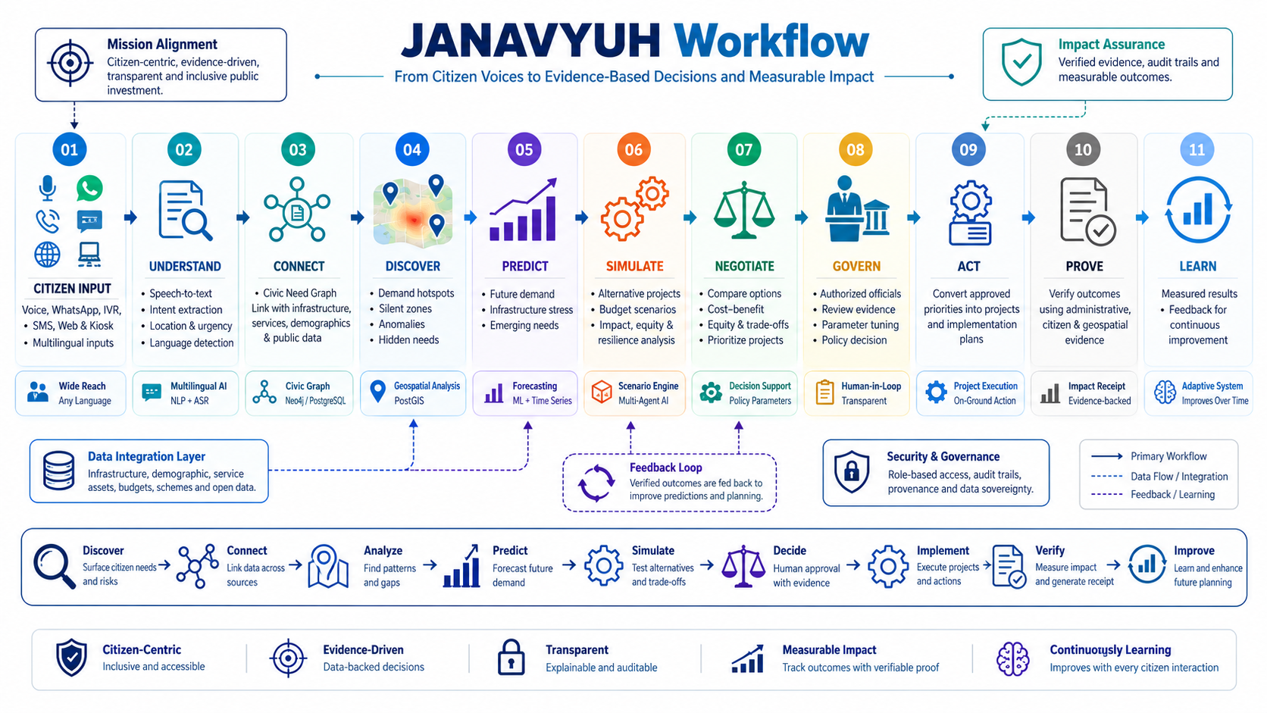

Slide 5
TECHNOLOGY USED &METHODLOGY
Technology Stack
• UI and Visualizations: React/Next.js and MapLibre / Leaflet for building dashboards and civic maps.
• Backend and APIs: Python / FastAPI for building data pipelines and APIs.
• LLM: Multilingual LLMs for intent extraction, reasoning, and summarization.
• Speech and Language: Whisper / Bhashini class ASR for speech recognition in regional languages.
• NLP and Embeddings: Sentence transformers and vector search for similarity and need clustering.
• Civic Knowledge Graph: Neo4j / PostgreSQL for linking needs, locations, assets and projects.
• Geo-intelligence: PostGIS and geospatial analytics for hotspots and silent zones.
• Prediction and analytics: HDBSCAN and anomaly detection with time series forecasting.
• Decision intelligence: Causal inference, multi-agent workflows, and scenario simulations.
• Security and deployment: RBAC, audit logs, Docker / Kubernetes, and sovereign data nodes.
Methodology
• Citizen Signal Capture: Capture voice, text and digital signals from various sources.
• Multilingual Translation: Transcribe voice into text and determine language, intent, location and urgency.
• Need Clustering: Cluster citizen signals based on semantics, geography and time.
• Civic Graph: Associate citizen need clusters with physical infrastructures, public services and development plans.
• Discovery and Detection: Detect hotspots, silent zones, anomalies and missing infrastructures.
• Need Projection: Project future demand on service and infrastructure capacity.
• Scenario Simulation: Analyze competing development projects, priorities and budgets.
• Multi-Agent Evaluation: Analyze project benefits, fairness, costs and resiliency tradeoffs.
• Human Judgment: Provide explainable analysis for informed decision-making.
• Impact Verification: Validate impact and produce evidence-based Impact Receipts.
Citizen Voice → AI Understanding → Graph Intelligence → Prediction → Simulation → Human Decision → Verified Impact → Continuous Learning

Slide 6
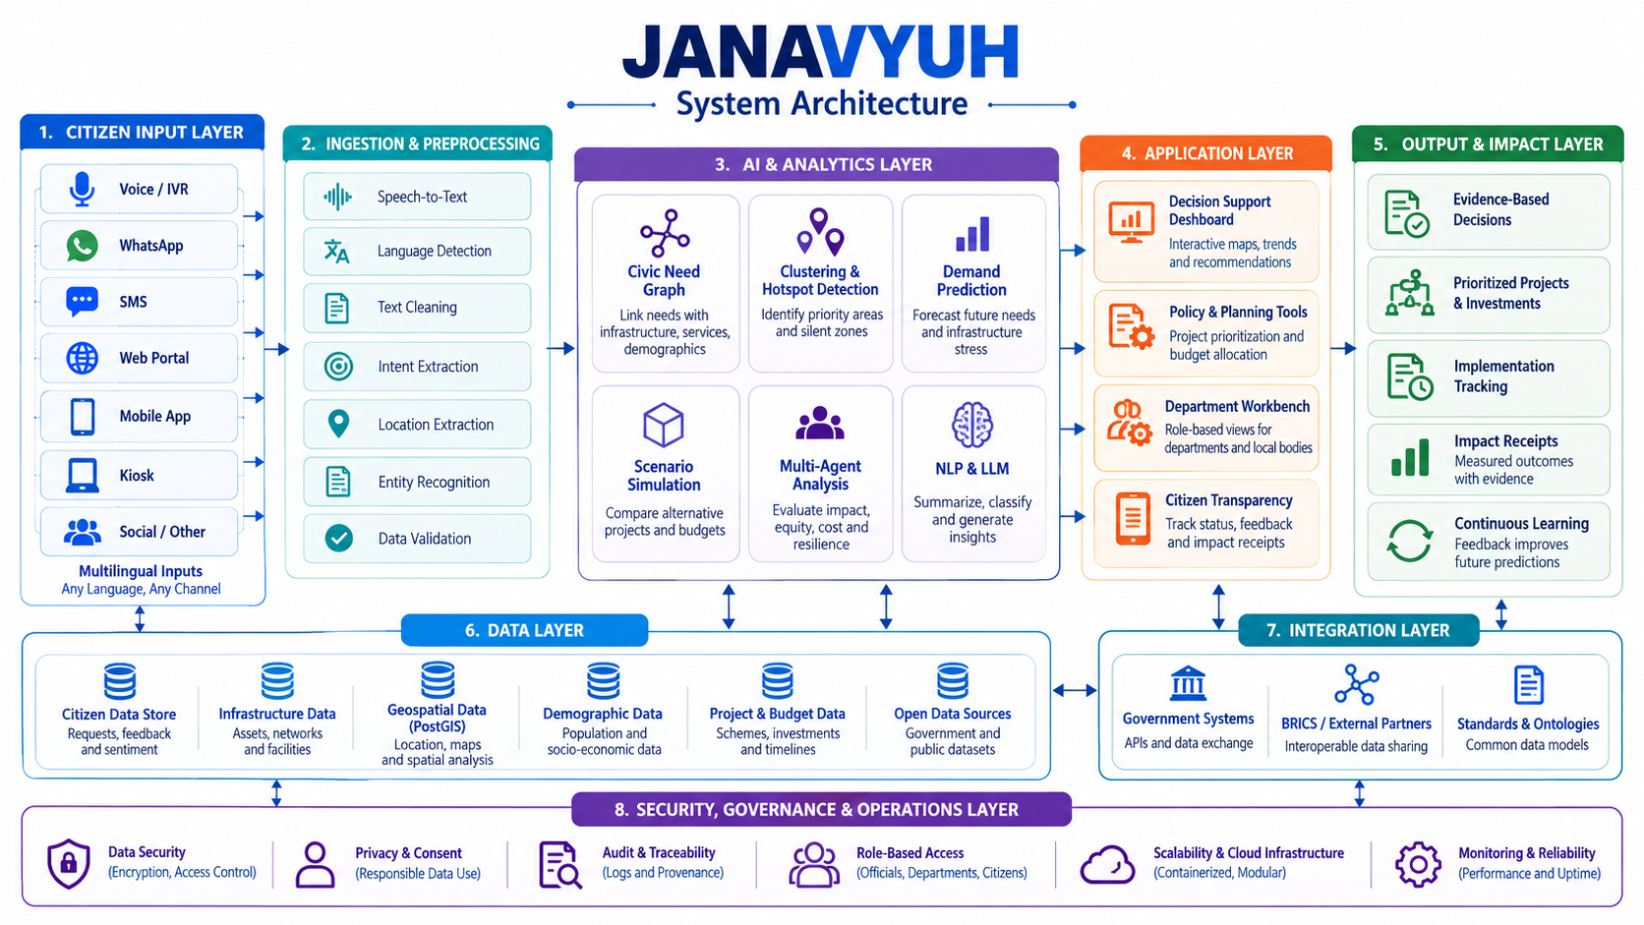

Slide 7
INNOVATION AND CREATIVITY OF IDEA
INNOVATION | WHAT MAKES JANAVYUH DISTINCT
Multichannel Citizen Intelligence | Unifies voice, WhatsApp, IVR, SMS, Web and kiosk inputs into one civic evidence layer.
Civic Need Graph | Connects citizen needs with locations, infrastructure, services, demographics and projects.
Silent-Zone Intelligence | Detects areas with low reporting but potential infrastructure/service gaps, reducing dependence on complaint volume alone.
Living Civic Digital Twin | Maintains a changing regional view of needs, assets, projects, investments and outcomes.
Counterfactual Policy Simulation | Tests alternative projects and budget scenarios before implementation to compare expected outcomes and trade-offs.
Multi-Agent Policy Arena | Separately evaluates impact, equity, budget and resilience before presenting an evidence-based decision view.
Impact Receipt | Links project implementation with post-project evidence instead of stopping at “project completed.”
Sovereign BRICS Architecture | Supports country-local data nodes, shared civic ontology and federation without requiring centralized citizen-data storage.

Slide 8
IMPACT & BENIFIT
SOCIAL IMPACT | ECONOMIC IMPACT | TECHNICAL IMPACT
Inclusive Citizen Participation — Voice and multilingual channels make reporting more accessible. | Better Resource Allocation — Connects needs with budgets and infrastructure priorities. | Multilingual Civic AI — Processes voice, text and regional-language inputs.
Hidden Needs Visibility — Silent zones help surface under-reported service gaps. | Reduced Planning Friction — Unifies fragmented evidence for faster analysis. | Civic Knowledge Graph — Links people, needs, assets, services and projects.
Greater Transparency — Citizens can track progress from request to outcome. | Future-Ready Planning — Forecasting helps identify emerging infrastructure demand. | Predictive & Scenario Intelligence — Forecasts demand and compares interventions.
Outcome-Based Accountability — Impact Receipts connect projects to measurable outcomes. | Portfolio-Level Decisions — Compare multiple projects and budget scenarios. | Sovereign Architecture — Supports country-local data governance and federation.
TARGET AUDIENCE
PRIMARY
Government & Policy Makers
Government Departments
Planning & Investment Teams
SECONDARY
Citizens & Communities
Municipal & Local Bodies
BRICS Public-Infrastructure Partners
CORE ECOSYSTEM
Citizens → Local Bodies → Departments → Policy Makers → Verified Public Impact

Slide 9
RESEARCH & REFERENCE
RESEARCH
Citizen Engagement & Responsive Governance – Research suggests that organized citizen engagement will help in increasing transparency and service delivery, as well as improving responsiveness.
Multilingual & Voice-based Access – Bhashini project reflects on how language and digital barriers can be overcome through the use of artificial intelligence-powered language technology, allowing access in Indian languages.
Whole-of-Government Digital Infrastructure – Digital government research includes interoperability, citizen engagement, and service delivery as essential features of mature digital government.
Data-driven Civic Intelligence – Janavvyuh incorporates citizens' inputs with infrastructure, demographic, geospatial, and investment data for facilitating the process of connected analysis instead of disconnected feedback analysis.
Digital Public Good Principles – The architecture takes into account such principles of DPG as open standards, privacy, documentation, platform independence, etc.
REFERENCES
World Bank – Citizen Engagement & CIVIC Digital
https://www.worldbank.org/ext/en/topic/social-development/citizen-engagement
World Bank – GovTech Maturity Index 2025
https://www.worldbank.org/en/programs/govtech/gtmi-2025-update
BHASHINI – National Language Translation Mission
https://bhashini.gov.in/about-bhashini
Digital Public Goods Alliance – DPG Standard
https://www.digitalpublicgoods.net/standard
PostGIS Documentation
https://postgis.net/documentation/

Slide 10
THANK YOU

